Slide 1



Bike sales analysis

Slide 2
Our team members
Yara Said (team leader)
Mahmoud Shaker
Kholoud Mostafa
Abdelhady Hussein
Amina Elshabandy
Nour Gad

Slide 3
Agenda
Objectives
DataSet Overview
Data cleaning
Data modeling
DAX
Sample visuals
Dashboard samples
Tableau dashboard
Key findings

Slide 4
1. Project objectives
This project aims to perform an in-depth analysis of bike sales data obtained from the AdventureWorks dataset, focusing on sales, customers, products, and regional performance. The goal is to develop actionable insights and data-driven visualizations to make higher profit ,to analyze sales performance across products and territories and to evaluate customer purchasing behavior and segment key demographics.

Slide 5
2. Dataset overview
Dataset from Adventureworks
6 (csv ) files

Slide 6
3. Data cleaning using power query in PowerBI
Loaded data
Structural Optimization
Data Quality Enhancement
Text Data Processing
Business Logic & Calculations
Data Integration

Slide 7
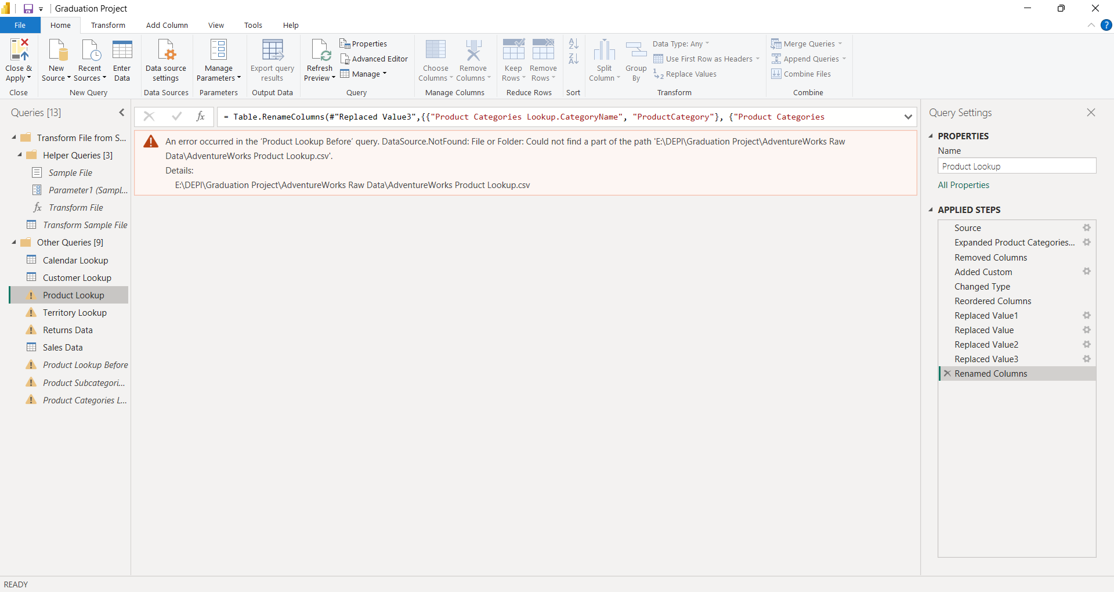
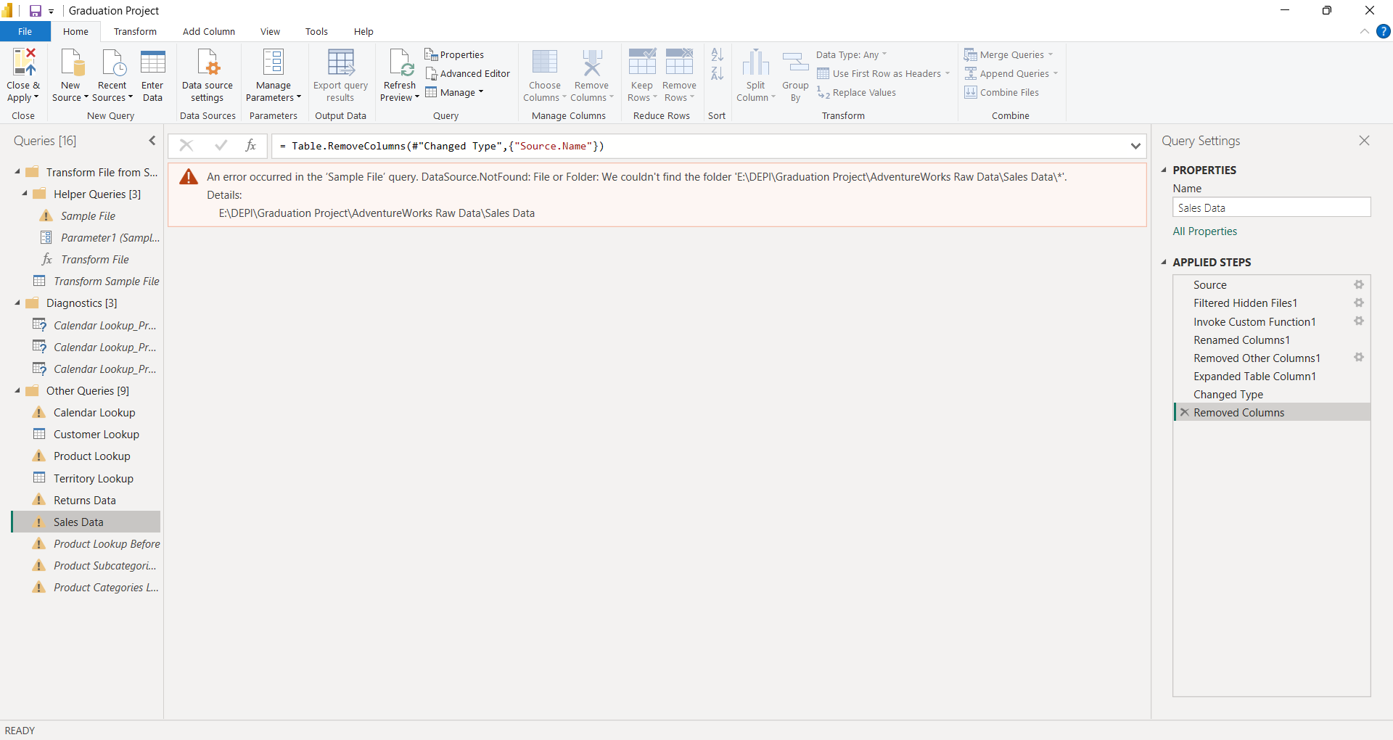
Some of the cleaning

Slide 8
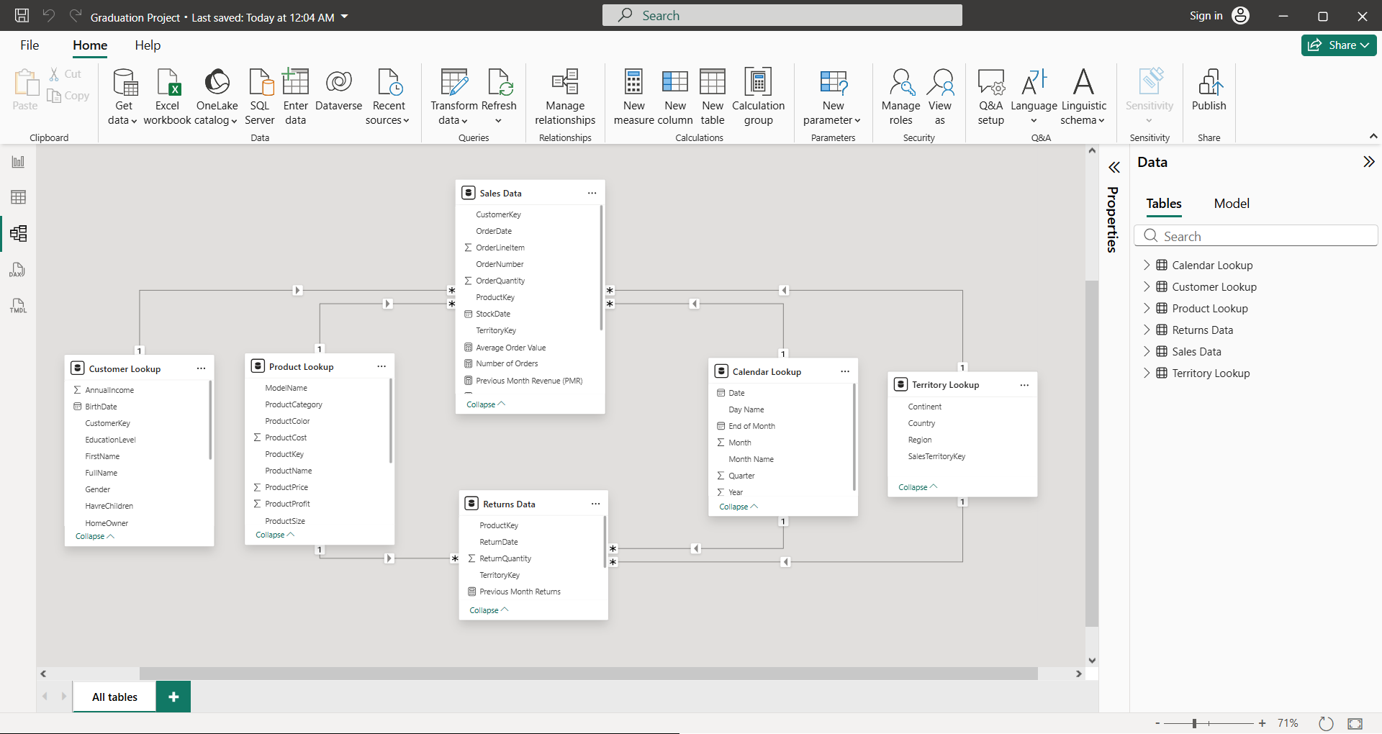
4. Data modeling

Slide 9
5. DAX
Examples:
Total Sales = SUM(FactInternetSales[SalesAmount])
Total Cost = SUM(FactInternetSales[TotalProductCost])
Total Profit = [Total Sales] – [Total Cost]
Profit Margin % = DIVIDE([Total Profit], [Total Sales])

Slide 10
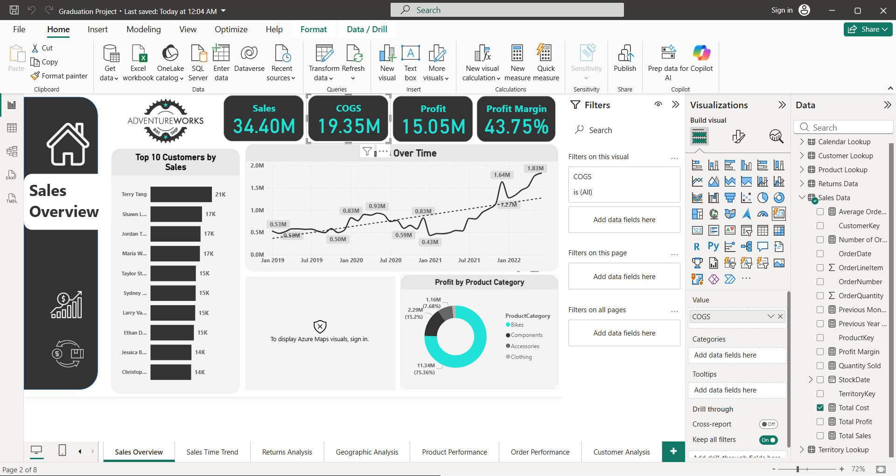
6. Sample visuals
Cards for single important value

Slide 11
6. Sample visuals
Line chart for trends over time

Slide 12
6. Sample visuals
Donut chart for distribution

Slide 13
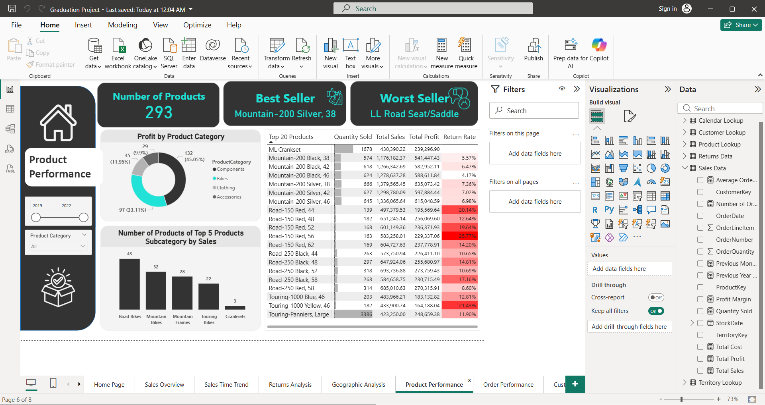
7. Dashboards samples

Slide 14
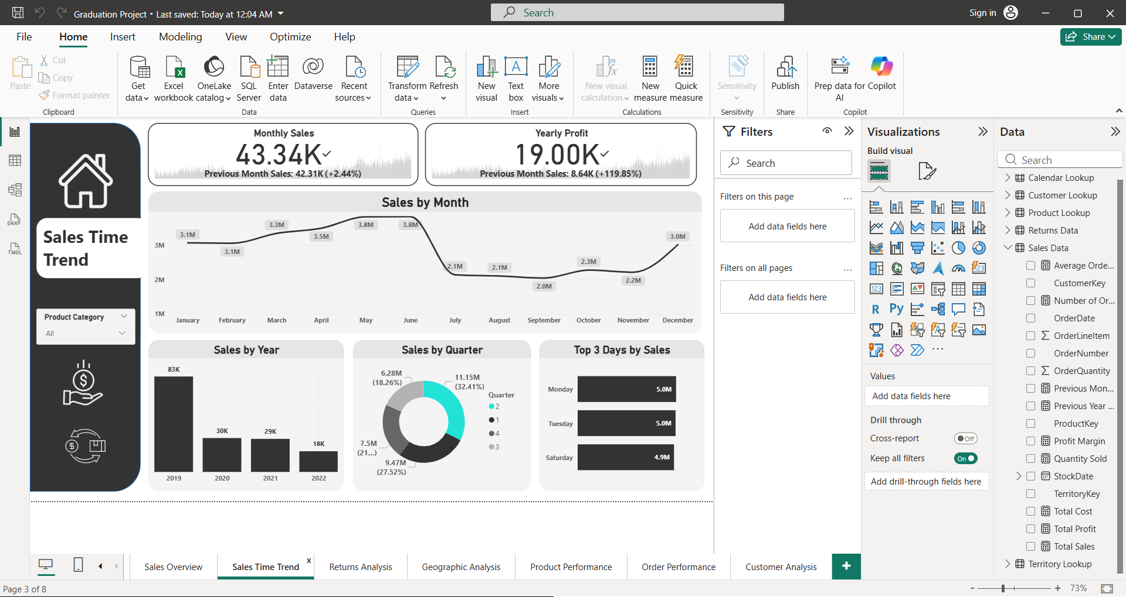
7.Dashboards samples

Slide 15
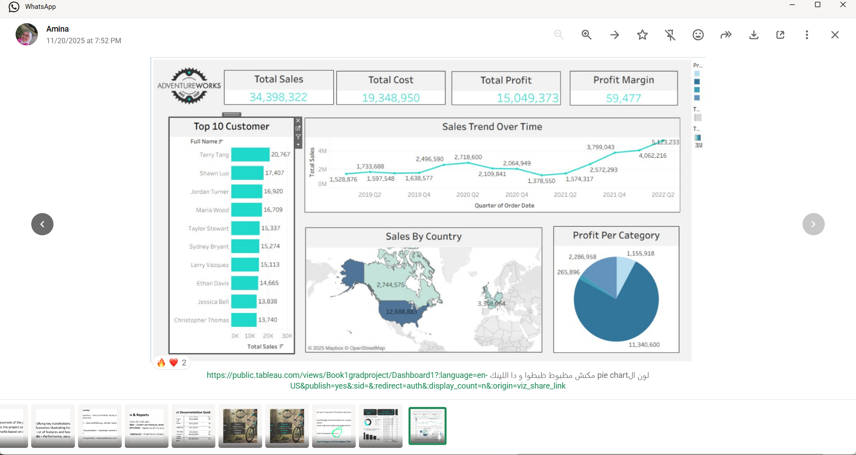
8. Tableau dashboard

Slide 16
9. Key results
We have a 5.94% return rate
Australia has the highest total sales & profit
Road bikes are the most sold bikes
Bikes are the most profitable product

Slide 17
Thank you !

